Slide 1
FUNDAMENTAL OF ALGORITHM
Lecturer: Saroj Poudel
Qualification : M.S CIS&IT
Lincoln University College,

Slide 2
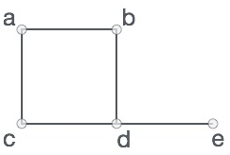


Concept and representation of graphs
Concept of graphs
A graph is a pictorial representation of a set of objects where some pairs of objects are connected by links.
Graph is a non linear data structure
A graph is a data structure that consists of the following two components:
A finite set of vertices also called as nodes.
A finite set of ordered pair of the form (u, v) called as edge. The pair is ordered because (u, v) is not the same as (v, u) in case of a directed graph(di-graph). The pair of the form (u, v) indicates that there is an edge from vertex u to vertex v. The edges may contain weight/value/cost
In this graph, V = {a, b, c, d, e} E = {ab, ac, bd, cd, de}

Slide 3
Concept and representation of graphs(contd)
Representation of graphs
In graph theory, a graph representation is a technique to store graph into the memory of computer.
To represent a graph, we just need the set of vertices, and for each vertex the neighbors of the vertex (vertices which is directly connected to it by an edge). If it is a weighted graph, then the weight will be associated with each edge.
There are different ways to optimally represent a graph, depending on the density of its edges, type of operations to be performed and ease of use.

Slide 4
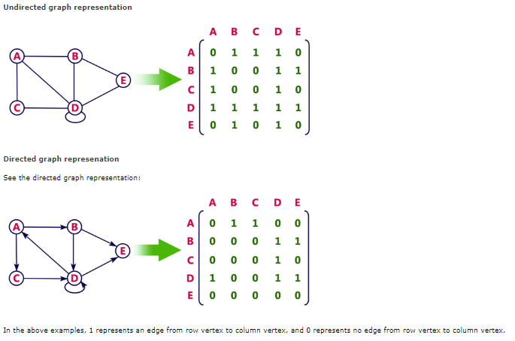
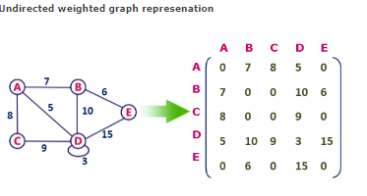
Concept and representation of graphs(contd)
Adjacency Matrix
Adjacency matrix is a sequential representation.
It is used to represent which nodes are adjacent to each other. i.e. is there any edge connecting nodes to a graph.
In this representation, we have to construct a n X n matrix A. If there is any edge from a vertex i to vertex j, then the corresponding element of A, a^{i},^{j} = 1, otherwise a^{i},^{j}= 0
If there is any weighted graph then instead of 1s and 0s, we can store the weight of the edge.

Slide 5
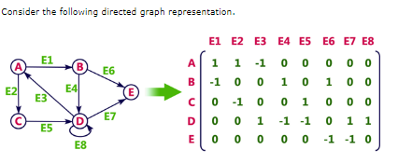
Concept and representation of graphs(contd)
Incidence matrix
In Incidence matrix representation, graph can be represented using a matrix of size:
Total number of vertices by total number of edges.
It means if a graph has 4 vertices and 6 edges, then it can be represented using a matrix of 4X6 class. In this matrix, columns represent edges and rows represent vertices.
This matrix is filled with either 0 or 1 or -1. Where,
0 is used to represent row edge which is not connected to column vertex.
1 is used to represent row edge which is connected as outgoing edge to column vertex.
-1 is used to represent row edge which is connected as incoming edge to column vertex

Slide 6
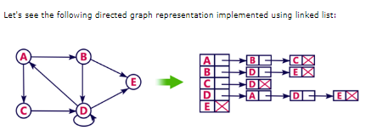
Concept and representation of graphs(contd)
Adjacency List
Adjacency list is a linked representation.
In this representation, for each vertex in the graph, we maintain the list of its neighbors. It means, every vertex of the graph contains list of its adjacent vertices.
We have an array of vertices which is indexed by the vertex number and for each vertex v, the corresponding array element points to a singly linked list of neighbors of v.

Slide 7
Graphs Traversal
BFS (Breath First Search)
BFS traversal of a graph produces a spanning tree as final result. Spanning Tree is a graph without loops. We use Queue data structure with maximum size of total number of vertices in the graph to implement BFS traversal
Define a Queue of size total number of vertices in the graph.
Select any vertex as starting point for traversal. Visit that vertex and insert it into the Queue.
Visit all the non-visited adjacent vertices of the vertex which is at front of the Queue and insert them into the Queue.
When there is no new vertex to be visited from the vertex which is at front of the Queue then delete that vertex.
Repeat steps 3 and 4 until queue becomes empty.
When queue becomes empty, then produce final spanning tree by removing unused edges from the graph
Example of DFS VS BFS on next page

Slide 8
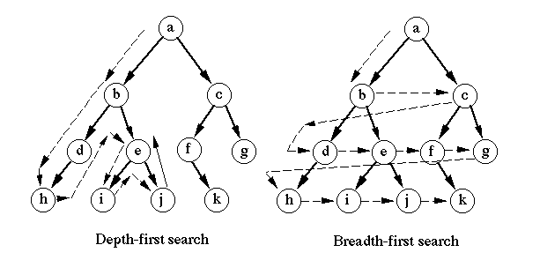
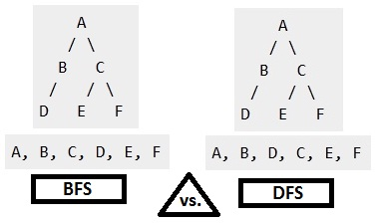

Slide 9
Analysis of BFS
The time complexity of the BFS algorithm is represented in the form of O(V + E), where V is the number of nodes and E is the number of edges.
The space complexity of the algorithm is O(V).
BFS Algorithm Applications
To build index by search index
For GPS navigation
Path finding algorithms

Slide 10
Greedy Algorithms
A greedy algorithm is an approach for solving a problem by selecting the best option available at the moment.
It doesn't worry whether the current best result will bring the overall optimal result.
The algorithm never reverses the earlier decision even if the choice is wrong. It works in a top-down approach.

Slide 11
Change making Problem
Given a value V, if we want to make a change for V Rs, and we have an infinite supply of each of the denominations in Nepali currency, i.e., we have an infinite supply of { 1, 2, 5, 10, 20, 50, 100, 500, 1000} valued coins/notes, what is the minimum number of coins and/or notes needed to make the change?
Approach: A common intuition would be to take coins with greater value first. This can reduce the total number of coins needed. Start from the largest possible denomination and keep adding denominations while the remaining value is greater than 0.

Slide 12
Algorithm
Sort the array of coins in decreasing order.
Initialize result as empty.
Find the largest denomination that is smaller or equals to the current amount.
Add found denomination to result. Subtract value of found denomination from amount.
If amount becomes 0, then print result.
Else repeat steps 3 and 4 for new value of V.

Slide 13
Limitation
The limitation of the greedy algorithm is that it may not provide an optimal solution for some denominations.
For example, the above algorithm fails to obtain the optimal solution for D={1,6,10} and n =13. In particular, it would provide a solution with four coins, i.e., S={10,1,1,1} .
However, the optimal solution for the said problem is three coins, i.e., S={6,6,1} .

Slide 14
Huffman coding
Huffman Coding is a technique of compressing data to reduce its size without losing any of the details.
It was first developed by David Huffman.
Huffman Coding is generally useful to compress the data in which there are frequently occurring characters.
The idea is to assign variable-length codes to input characters, lengths of the assigned codes are based on the frequencies of corresponding characters.

Slide 15
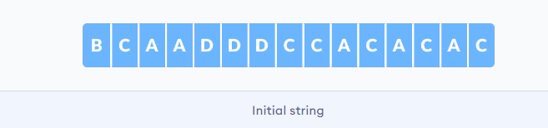
How it works?
Each character occupies 8 bits. There are a total of 15 characters in the above string. Thus, a total of 8 * 15 = 120 bits are required to send this string.
Using the Huffman Coding technique, we can compress the string to a smaller size

Slide 16
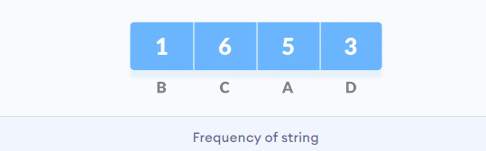
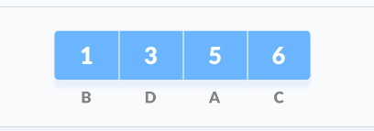
1. Calculate the frequency of each character in the string.
2. Sort the characters in increasing order of the frequency. These are stored in a priority queue Q.

Slide 17
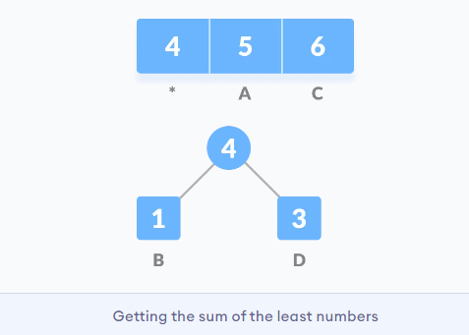
3. Make each unique character as a leaf node.
4. Create an empty node z. Assign the minimum frequency to the left child of z and assign the second minimum frequency to the right child of z. Set the value of the z as the sum of the above two minimum frequencies.

Slide 18
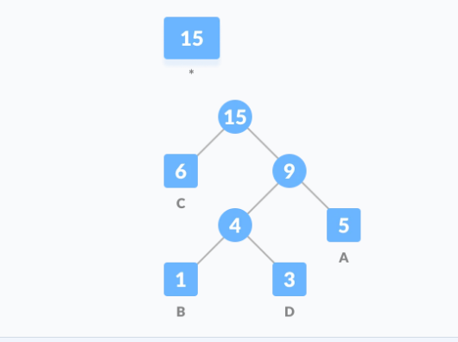
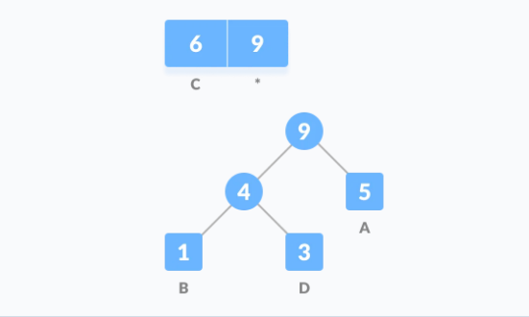
5. Remove these two minimum frequencies from Q and add the sum into the list of frequencies (* denote the internal nodes in the figure above).
6. Insert node z into the tree.
7. Repeat steps 3 to 5 for all the characters.

Slide 19
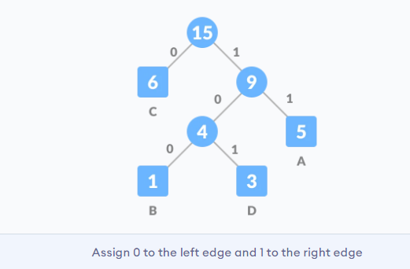
8. For each non-leaf node, assign 0 to the left edge and 1 to the right edge.

Slide 20
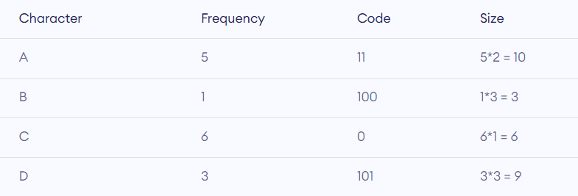
For sending the above string over a network, we have to send the tree as well as the above compressed-code. The total size is given by the table below.

Slide 21
Real-life applications of Huffman Encoding
Huffman encoding is widely used in compression formats like GZIP, PKZIP (winzip) and BZIP2.
Huffman encoding still dominates the compression industry since newer arithmetic and range coding schemes are avoided due to their patent issues.

